Slide 1

WG Research Data Collections An overview of the recommendation
Tobias Weigel, Bridget Almas, Frederik Baumgardt, Thomas Zastrow, Ulrich Schwardmann, Maggie Hellstrom, Javier Quinteros, Dirk Fleischer
CC-BY 4.0

Slide 2

Motivation for Research Data Collections
(Research) data management beyond single objects
Not just describe collections, but enable actions on them
Create, Read, Update, Delete, List plus some others
Machine agents as primary users
Contribute an essential component to the Data Fabric
API specification against which tools and services can be built across community boundaries
Create
Read
Update
Delete
List

Slide 3
What is the output?
1. Collection recommendation document
2. API specification (Swagger / OpenAPI)
3. Reference implementations
https://github.com/RDACollectionsWG/specification
https://github.com/RDACollectionsWG/apidocs

Slide 4
Key API requirements
Support for PIDs, but not mandatory
Support for non-recursive subcollections
Objects may belong to more than one collection
Object properties specific within a collection‘s context
Cross-repository collections supported, separation of object location from collection membership
No limitation to particular back-ends
Advertised service/object operations for machine consumption
Advertised collection capabilities (usage, behavioural restrictions)

Slide 5
High-level conceptual model
ID
location
description
ontology
datatype
mappings
Capabilities
role
index
date added
date updated
ID
Properties
Membership
Member
Member
Member

Slide 6
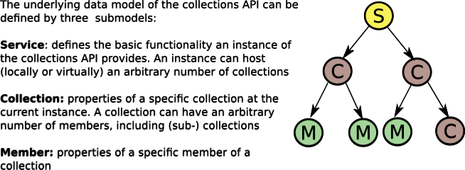
API: Structure

Slide 7
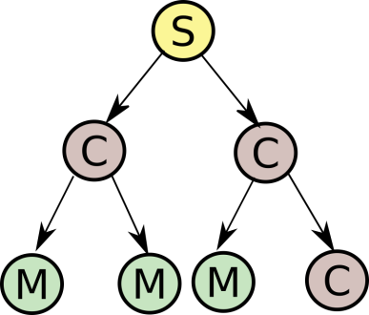
API: Details
Service:
Understand service features
Collection:
CRUD/L
Understand capabilities
Member:
CRUD/L
Location, datatype, mappings

Slide 8
API: Details

Slide 9
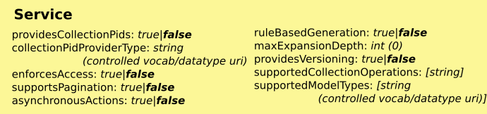
API: Service Features
GET /features

Slide 10
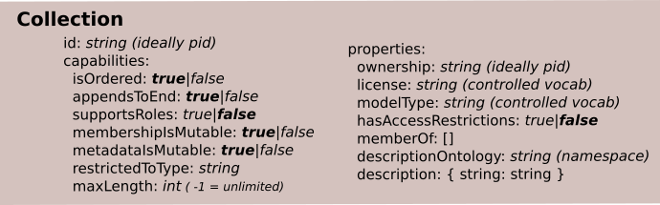
API: Collections Create/Read/Update/Delete/List
LIST GET /collections CREATE POST /collections READ GET /collections/{id} UPDATE PUT /collections/{id} DELETE DELETE /collections/{id}

Slide 11
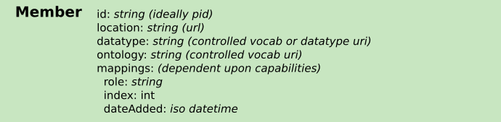
API: Collection Member CRUD/L
LIST GET /collections/{id}/members CREATE POST /collections/{id}/members READ GET /collections/{id}/members/{mid} UPDATE PUT /collections/{id}/members/{mid} DELETE DELETE /collections/{id}/members/{mid}

Slide 12
Impact
Before
after
Incompatible silo approaches to collection management
focus on describing collections, not CRUD operations
missing conceptual framework, unclear scope
Clients:
interaction with endpoints independent of domain/infrastructure etc.
common toolset ecosystems
Servers:
balance: conformance with basic functionality vs. extensions
multi-domain service building, reusability

Slide 13

Reference Implementations
Source code available at GitHub.com/RDACollectionsWG
API mockup (Swagger-based, Python)
Ruby Collections client (Swagger Codegen)
Reptor: PHP-based modern data repository demonstrator
PID handling, independent of particular systems
file system storage of object bitstreams
Support for DTR, OAI-PMH, ResourceSync
Perseids Manifold: Python/Flask-based + LDP
multiple data backends: file system, RDF/LDP, MongoDB
deployed at http://collections.perseids.org
GEOFON implementation: Python/cherrypy + MySQL
members identified by PID or URL
extended with download methods for collections and members

Slide 14

Open and future efforts
Comprehensive approach for Data Type Registry integration included in the recommendation
Needs further practical evaluation as part of test beds
Some first steps done as part of adoption
Fedora Commons: Possible support for API via Fedora API-X service
Specification offers extension points to explore
More operations
Maturing the conceptual framework
Feedback through RDA processes desired!

Slide 15
Adoption: GEOFON
Create big pre-assembled datasets (collections) without the need to instantiate them due to storage limitations
PIDs for data files were already available and should be used to identify members of the collections
Extension to the specification with “download” methods for collections and members
Interoperability with data storage sytem (iRODS), Handle Server and AAI system.
6000+ collections and 1.5+ million members
Contact: Javier Quinteros

Slide 16
Adoption: Perseids
Collections of Textual and Linguistic Annotations
Annotation documents belong to multiple collections
User, Subject, Community, Review Board
Collection membership changes throughout the research/publication lifecycle
Collections add and set the context for the data
Currently: CRUD operations used. Goals require addition of Query and Set based operations.
Want to combine with PID Kernel and DTR outputs to have persistently identified annotations asserted with machine actionable formalized datatypes
Contact: Bridget Almas

Slide 17
Adoption: ePIC
ePIC Collection Registry: Flask-based, uses registered types (DTR)
allows multiple prefix-based registries
backend: Handle System and file system
Ready-to-use service – to be available soon under: https://coll-reg.pidconsortium.eu
Contact: Ulrich Schwardmann

